Slide 1
CONNECTIONIST METHODS

Slide 2
Non Symbolic Representations
Decision trees can be easily read
  A disjunction of conjunctions (logic)
  We call this a symbolic representation
Non-symbolic representations
  More numerical in nature, more difficult to read
Artificial Neural Networks (ANNs)
  A Non-symbolic representation scheme
  They embed a giant mathematical function
    To take inputs and compute an output which is interpreted as a categorisation
  Often shortened to “Neural Networks”
    Don’t confuse them with real neural networks (in heads)

Slide 3
Function Learning
Map categorisation learning to numerical problem
  Each category given a number
  Or a range of real valued numbers (e.g., 0.5 - 0.9)
Function learning examples
  Input = 1,2,3,4 Output = 1,4,9,16
    Here the concept to learn is squaring integers
  Input = [1,2,3], [2,3,4], [3,4,5], [4,5,6], Output = 1, 5, 11, 19
    Here the concept is: [a,b,c] -> a*c - b
    The calculation is more complicated than in the first example
Neural networks:
  Calculation is much more complicated in general
  But it is still just a numerical calculation

Slide 4

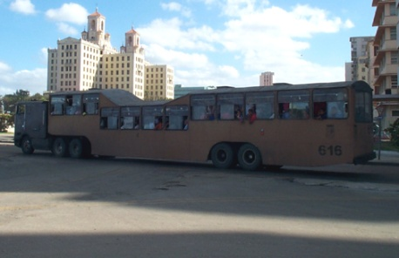


Complicated Example:Categorising Vehicles
Input to function: pixel data from vehicle images
  Output: numbers: 1 for a car; 2 for a bus; 3 for a tank
INPUT INPUT INPUT INPUT
OUTPUT = 3 OUTPUT = 2 OUTPUT = 1 OUTPUT=1

Slide 5
So, what functions can we use?
Biological motivation:
  The brain does categorisation tasks like this easily
  The brain is made up of networks of neurons
Naturally occurring neural networks
  Each neuron is connected to many others
    Input to one neuron is the output from many others
    Neuron “fires” if a weighted sum S of inputs > threshold
Artificial neural networks
  Similar hierarchy with neurons firing
  Don’t take the analogy too far
    Human brains: 100,000,000,000 neurons
    ANNs: < 1000 usually
    ANNs are a gross simplification of real neural networks

Slide 6
General Idea
Value calculated using
all the input unit values
Choose CAT output
(for a given output value)
INPUT LAYER
HIDDEN LAYERS
OUTPUT LAYER CATEGORY
1.1
2.7
7.1
1.1
Cat A
4.2
NUMBERS INPUT
0.2
3.0
Cat B
2.1
NUMBERS OUTPUT
-0.8
-1.3
-1.2
0.3
Cat C
2.7
VALUES PROPAGATE THROUGH THE NETWORK

Slide 7
Representation of Information
If ANNs can correctly identify vehicles
  They then contain some notion of “car”, “bus”, etc.
The categorisation is produced by the units (nodes)
  Exactly how the input reals are turned into outputs!
But, in practice:
  Each unit does the same calculation
    But it is based on the weighted sum of inputs to the unit
  So, the weights in the weighted sum
    Is where the information is really stored
“Black Box” representation:
  Useful knowledge about learned concept is difficult to extract

Slide 8
ANN learning problem
Given a categorisation to learn (expressed numerically)
  And training examples represented numerically
    With the correct categorisation for each example
Learn a neural network using the examples
  which produces the correct output for unseen examples
Boils down to
  (a) Choosing the correct network architecture
    Number of hidden layers, number of units, etc.
  (b) Choosing (the same) function for each unit
  (c) Training the weights between units to work correctly

Slide 9
Perceptron

Slide 10
Simplest ANN - Perceptron
Multiple input nodes
Single output node
  Takes a weighted sum of the inputs, call this S
  Unit function calculates the output for the network
Useful to study because
  We can use perceptrons to build larger networks
Perceptrons have limited representational abilities

Slide 11
Unit Functions
Step
Function
Sigma
Function
Linear Functions
  Simply output the weighted sum
Threshold Functions
  Output low values
    Until the weighted sum gets over a threshold
    Then output high values
    Equivalent of “firing” of neurons
Step function:
  Output +1 if S > Threshold T
  Output –1 otherwise
Sigma function:
  Similar to step function but differentiable

Slide 12
Example Perceptron
Categorisation of 2x2 pixel black & white images
  Into “bright” and “dark”
Representation of this rule:
  If it contains 2, 3 or 4 white pixels, it is “bright”
  If it contains 0 or 1 white pixels, it is “dark”
Perceptron architecture:
  Four input units, one for each pixel
  One output unit: +1 for white, -1 for dark

Slide 13
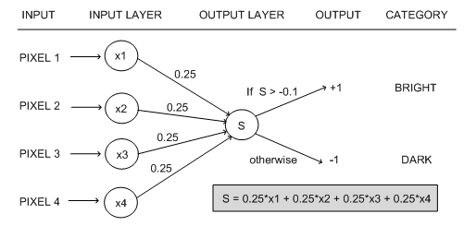

Example Perceptron
Example calculation: x₁=-1, x₂=1, x₃=1, x₄=-1
  S = 0.25*(-1) + 0.25*(1) + 0.25*(1) + 0.25*(-1) = 0
0 > -0.1, so the output from the ANN is +1
  So the image is categorised as “bright”

Slide 14
Learning in Perceptrons
Need to learn
  Both the weights between input and output units
  And the value for the threshold
Make calculations easier by
  Thinking of the threshold as a weight from a special input unit where the output from the unit is always 1
Exactly the same result
  But we only have to worry about learning weights

Slide 15
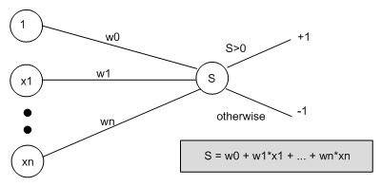
New Representation for Perceptrons
Special Input Unit
Always produces 1
Threshold function
has become this

Slide 16
Learning Algorithm
Weights are set randomly initially
For each training example E
  Calculate the observed output from the ANN, o(E)
  If the target output t(E) is different to o(E)
    Then tweak all the weights so that o(E) gets closer to t(E)
    Tweaking is done by perceptron training rule
This routine is done for every example E
Don’t necessarily stop when all examples used
  Repeat the cycle again (an ‘epoch’)
  Until the ANN produces the correct output
    For all the examples in the training set (or good enough)

Slide 17
Perceptron Training Rule
When t(E) is different to o(E)
  Add on Δ_{i} to weight w_{i}
  Where Δ_{i} = η(t(E)-o(E))x_{i}
  Do this for every weight in the network
Interpretation:
  (t(E) – o(E)) will either be +2 or –2 [cannot be the same sign]
  So we can think of the addition of Δ_{i} as the movement of the weight in a direction
    Which will improve the networks performance with respect to E
  Multiplication by xi
    Moves it more if the input is bigger

Slide 18
The Learning Rate
η is called the learning rate
  Usually set to something small (e.g., 0.1)
To control the movement of the weights
  Not to move too far for one example
  Which may over-compensate for another example
If a large movement is actually necessary for the weights to correctly categorise E
  This will occur over time with multiple epochs

Slide 19
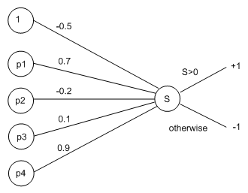
Worked Example
Return to the “bright” and “dark” example
Use a learning rate of η = 0.1
Suppose we have set random weights:

Slide 20
Worked Example
Use this training example, E, to update weights:
Here, x1 = -1, x2 = 1, x3 = 1, x4 = -1 as before
Propagate this information through the network:
  S = (-0.5 * 1) + (0.7 * -1) + (-0.2 * +1) + (0.1 * +1) + (0.9 * -1) = -2.2
Hence the network outputs o(E) = -1
But this should have been “bright”=+1
  So t(E) = +1

Slide 21
Calculating the Error Values
Δ₀ = η(t(E)-o(E))x₀
  = 0.1 * (1 - (-1)) * (1) = 0.1 * (2) = 0.2
Δ₁ = η(t(E)-o(E))x₁
  = 0.1 * (1 - (-1)) * (-1) = 0.1 * (-2) = -0.2
Δ₂ = η(t(E)-o(E))x₂
  = 0.1 * (1 - (-1)) * (1) = 0.1 * (2) = 0.2
Δ₃ = η(t(E)-o(E))x₃
  = 0.1 * (1 - (-1)) * (1) = 0.1 * (2) = 0.2
Δ₄ = η(t(E)-o(E))x₄
  = 0.1 * (1 - (-1)) * (-1) = 0.1 * (-2) = -0.2

Slide 22
Calculating the New Weights
w’₀ = -0.5 + Δ₀ = -0.5 + 0.2 = -0.3
w’₁ = 0.7 + Δ₁ = 0.7 + -0.2 = 0.5
w’₂ = -0.2 + Δ₂ = -0.2 + 0.2 = 0
w’₃= 0.1 + Δ₃ = 0.1 + 0.2 = 0.3
w’₄ = 0.9 + Δ₄ = 0.9 - 0.2 = 0.7

Slide 23
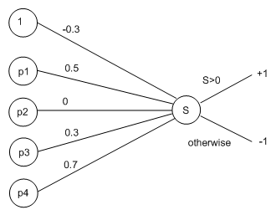
New Look Perceptron
Calculate for the example, E, again:
  S = (-0.3 * 1) + (0.5 * -1) + (0 * +1) + (0.3 * +1) + (0.7 * -1) = -1.2
Still gets the wrong categorisation
  But the value is closer to zero (from -2.2 to -1.2)
  In a few epochs time, this example will be correctly categorised

Slide 24
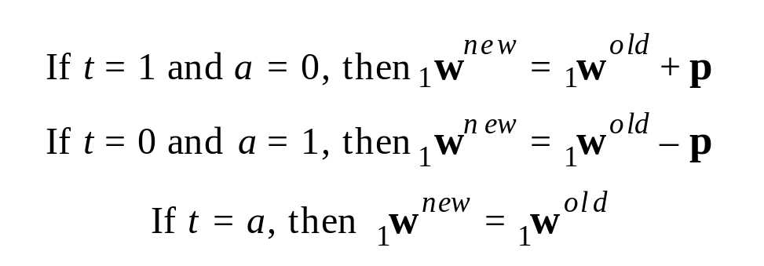

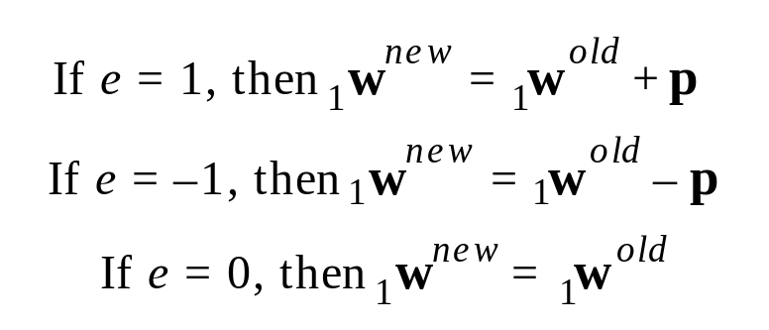

Unified Perceptron Learning Rule
These three rules can be rewritten as a single expression. First we will define a new variable, the perceptron error e:

Slide 25
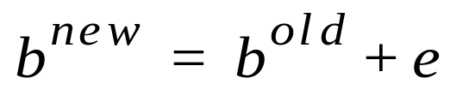
Unified Learning Rule cont’d
This rule can be extended to train the bias by noting that a bias is simply a weight whose input is always 1 i.e. p=1
We can thus replace the input p in the Eq. below with the input to the bias, which is 1.
The result is the perceptron rule for a bias:

Slide 26




Multiple-Neuron Perceptrons
To update the ith row of the weight matrix:
Matrix form:

Slide 27
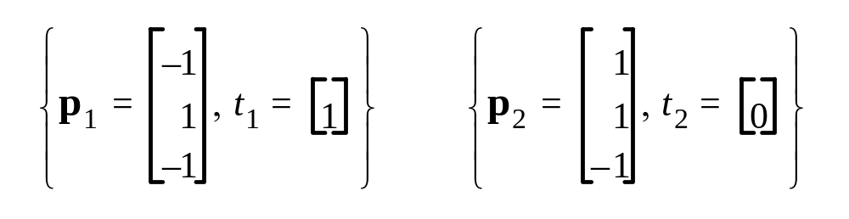
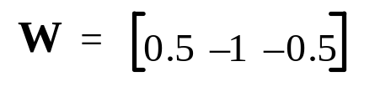

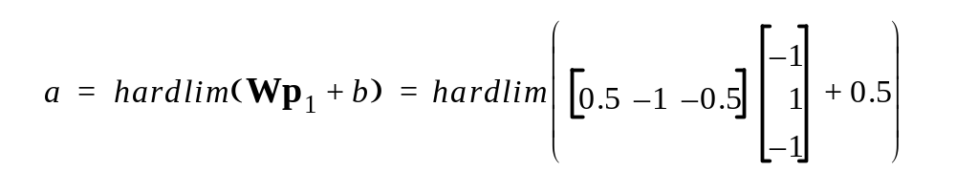

Apple/Banana Example
Training Set
Initial Weights
First Iteration
e
=
t
–
a
=
1
–
0
=
1
1

Slide 28
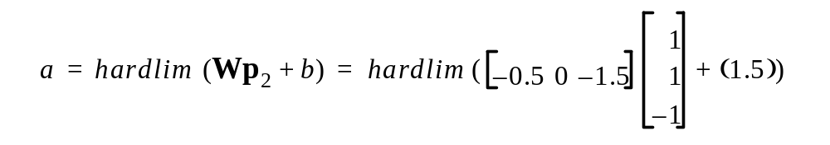



Second Iteration

Slide 29
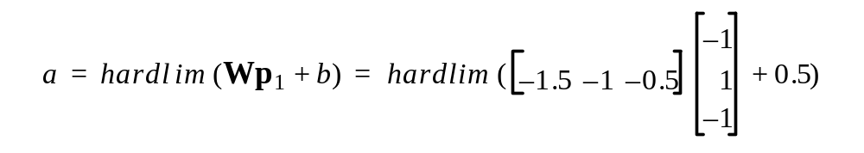

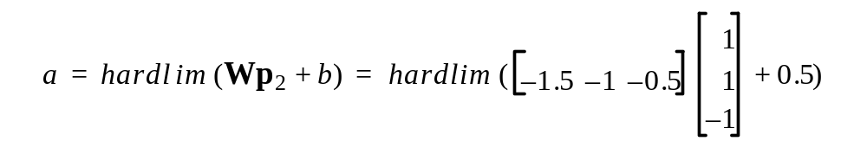
Check

Slide 30
Perceptron Rule Capability
Proof of Convergence: can consider it as exercise!
The perceptron rule will always converge to weights which accomplish the desired classification, assuming that such weights exist.

Slide 31
Learning Abilities of Perceptrons
Perceptrons are a very simple network
Computational learning theory
  Study of which concepts can and can’t be learned
    By particular learning techniques (representation, method)
Cannot learn some simple boolean functions
Caused a “winter” of research for ANNs in AI
  People thought it represented a fundamental limitation
  But perceptrons are the simplest network
  ANNS were revived by used of layered networks and backpropagation to solve non-linear problems.

Slide 32
Boolean Functions
Take in two inputs (-1 or +1)
Produce one output (-1 or +1)
In other contexts, use 0 and 1
Example: AND function
  Produces +1 only if both inputs are +1
Example: OR function
  Produces +1 if either inputs are +1

Slide 33
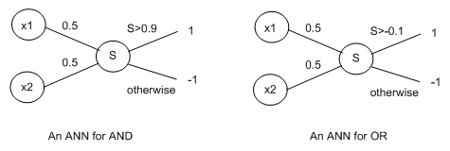
Boolean Functions as Perceptrons
Problem: XOR boolean function
  Produces +1 only if inputs are different
  Cannot be represented as a perceptron
  Because it is not linearly separable

Slide 34
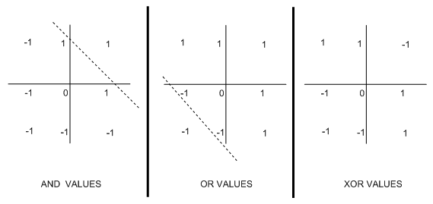
Linearly Separable Boolean Functions
Linearly separable:
  Can use a line (dotted) to separate +1 and –1
Think of the line as representing the threshold
  Angle of line determined by two weights in perceptron
  Y-axis crossing determined by threshold

Slide 35
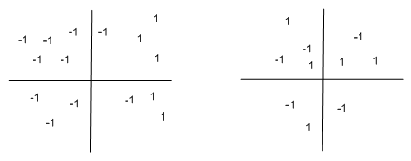
Linearly Separable Functions
Result extends to functions taking many inputs
  And outputting +1 and –1
Also extends to higher dimensions for outputs

Slide 36
Competitive Networks

Slide 37
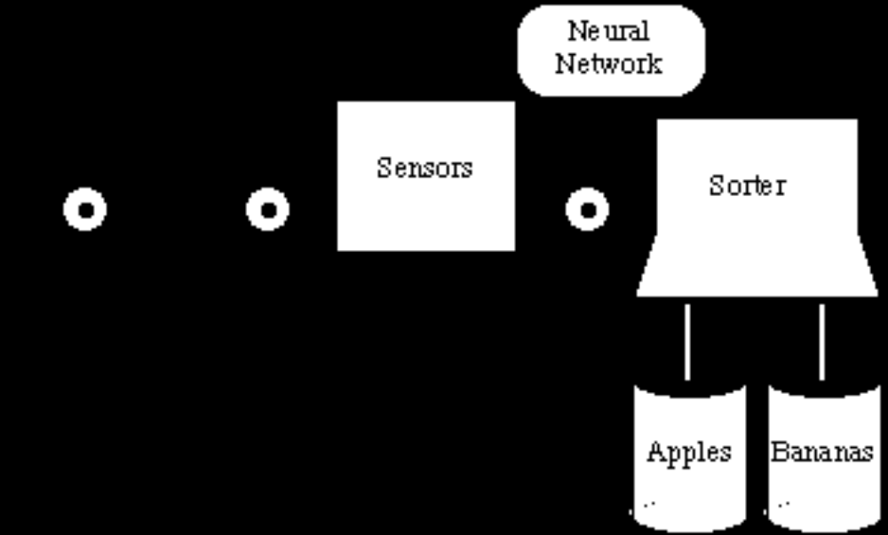
Apple/Banana Sorter
Recall the Banana/Apple problem

Slide 38
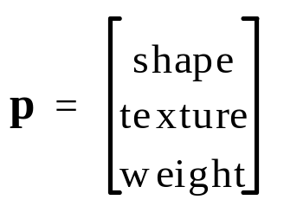
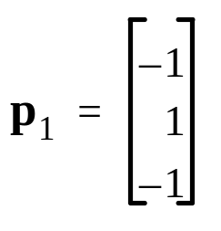
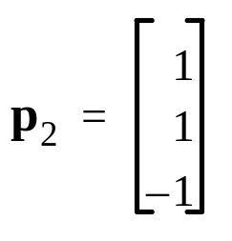
Prototype Vectors
Measurement
Vector
Prototype Banana
Prototype Apple
Shape: {1 : round ; -1 : eliptical}
Texture: {1 : smooth ; -1 : rough}
Weight: {1 : > 1 lb. ; -1 : < 1 lb.}
The neural network will receive one three-dimensional input vector for each fruit on the conveyer and must make a decision as to whether the fruit is a banana (p₁) or an apple (p₂).

Slide 39

Feedforward network
Recall for a Perceptron (an example of a feedforward network) it can be shown that the classification (decision boundary) can be achieved by developing weights w and a bias b such that:

Slide 40
Hamming Network
It was designed explicitly to solve binary pattern recognition problems (where each element of the input vector has only two possible values — in the banana/apple example we have 1 or -1).
it uses both feedforward and recurrent (feedback) layers
Note that the number of neurons in the first layer is the same as the number of neurons in the second layer.

Slide 41
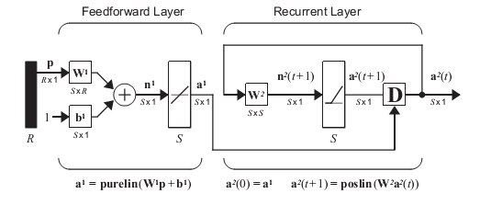
Hamming Network cont’d

Slide 42
Hamming Network cont’d
General Concepts on Hamming network operation:
The objective of the Hamming network is to decide which prototype vector is closest to the input vector.
This decision is indicated by the output of the recurrent layer.
There is one neuron in the recurrent layer for each prototype pattern. When the recurrent layer converges, there will be only one neuron with nonzero output.
This neuron indicates the prototype pattern that is closest to the input vector.

Slide 43
Hamming Network cont’d
Feedforward Layer
The feedforward layer performs a correlation, or inner product, between each of the prototype patterns and the input pattern
In order for the feedforward layer to perform this correlation, the rows of the weight matrix in the feedforward layer, represented by the connection matrix w¹, are set to the prototype patterns.

Slide 44
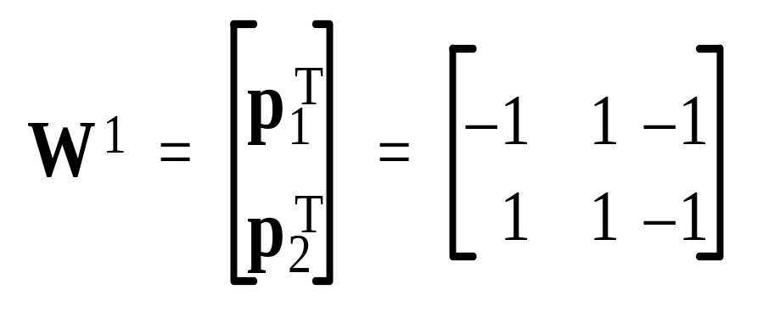
Hamming Network cont’d
Based on the Banana/Apple example this would mean:
Prototype Banana
Prototype Apple

Slide 45
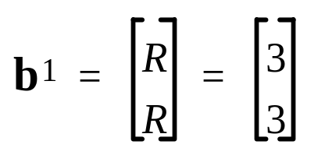
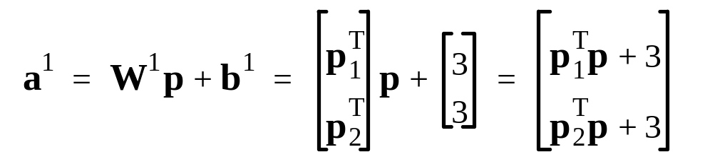
Hamming Network cont’d
The feedforward layer uses a linear transfer function, and each element of the bias vector b is equal to R, where R is the number of elements in the input vector
For our banana/apple example the bias vector would be:
With these choices for the weight matrix and bias vector, the
output of the feedforward layer is:

Slide 46
Hamming Network cont’d
Remark:
Note that the outputs of the feedforward layer are equal to the inner products of each prototype pattern with the input, plus R. For two vectors of equal length, their inner product will be largest when the vectors point in the same direction, and will be smallest when they point in opposite directions.
By adding R to the inner product we guarantee that the outputs of the feedforward layer can never be negative.

Slide 47
Hamming Network cont’d
This network is called the Hamming network because the neuron in the feedforward layer with the largest output will correspond to the prototype pattern that is closest in Hamming distance to the input pattern.
The Hamming distance between two vectors is equal to the number of elements that are different, defined only for binary vectors.

Slide 48
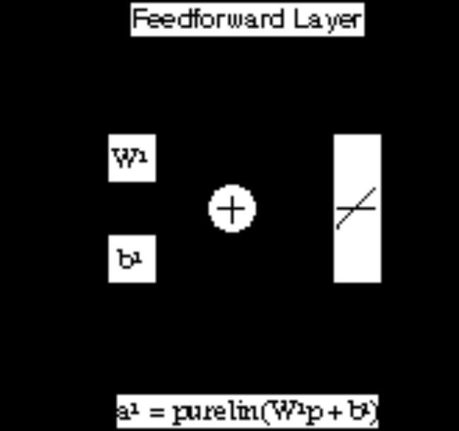

Summary - Feedforward Layer
For Banana/Apple Recognition

Slide 49
Hamming Network cont’d
Recurrent Layer
The recurrent layer of the Hamming network is what is known as a “competitive” layer.
The neurons in this layer are initialized with the outputs of the feedforward layer, which indicate the correlation between the prototype patterns and the input vector.
Then the neurons compete with each other to determine a winner.
After the competition, only one neuron will have a nonzero output. The winning neuron indicates which category of in-put was presented to the network

Slide 50


Hamming Network cont’d
The competition is governed by the equation:
Where;
Here 2 represents the layer number not a power!
The transfer function poslin is linear for positive values and zero for negative values

Slide 51

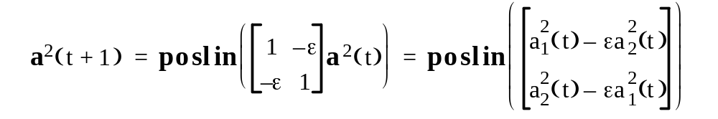
Hamming Network cont’d
The weight matrix W² has the form:
where ε is some number less than 1 / (S-1), and S is the number of neurons in the recurrent layer.
An iteration of the recurrent layer proceeds as follows:

Slide 52
Hamming Network cont’d
From above it is clear that:
Each element is reduced by the same fraction of the other. The larger element will be reduced by less, and the smaller element will be reduced by more, therefore the difference between large and small will be increased.
The effect of the recurrent layer is to zero out all neuron outputs, except the one with the largest initial value (which corresponds to the prototype pattern that is closest in Hamming distance to the input! ).

Slide 53
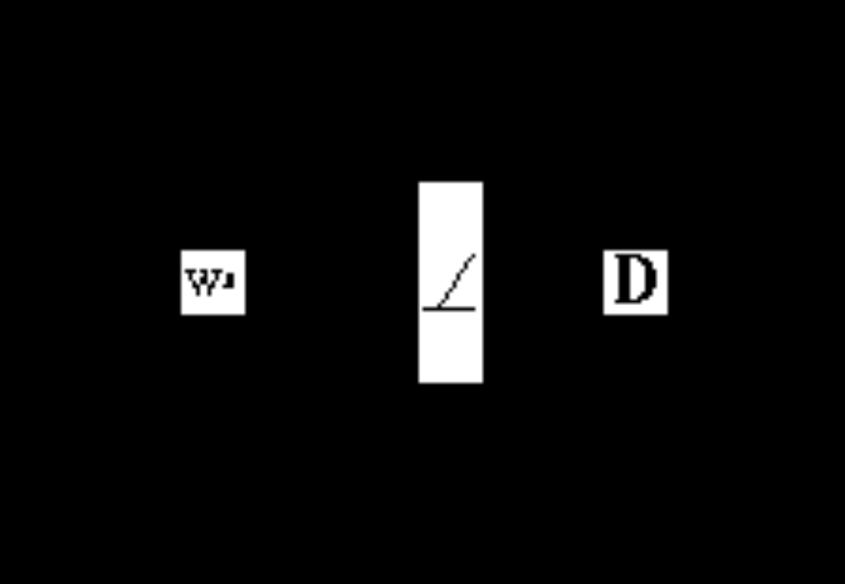
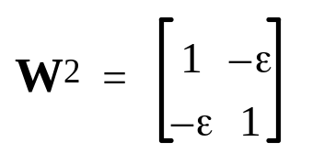
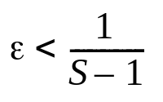
Summary - Recurrent Layer

Slide 54
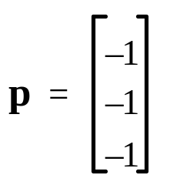
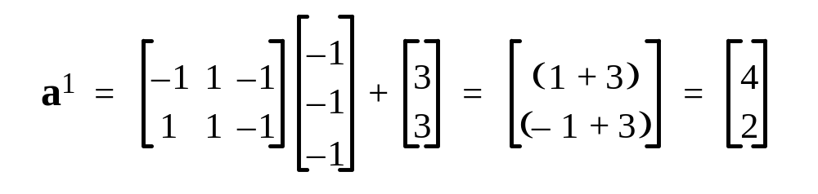
Illustrative Example
Prototype Banana
Prototype Apple
First Layer
Input (Rough Banana)
Shape: {1 : round ; -1 : eliptical}
Texture: {1 : smooth ; -1 : rough}
Weight: {1 : > 1 lb. ; -1 : < 1 lb.}

Slide 55
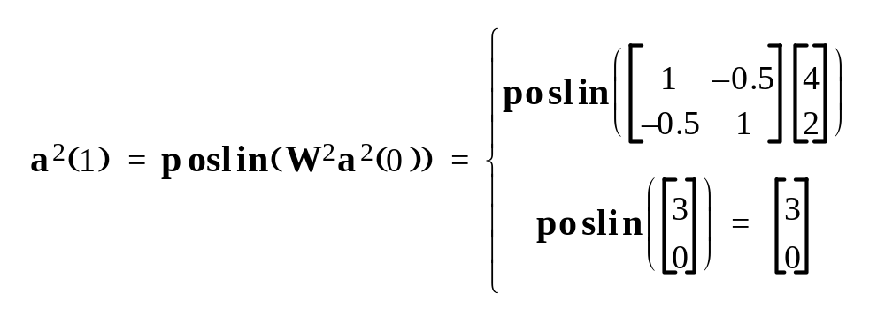
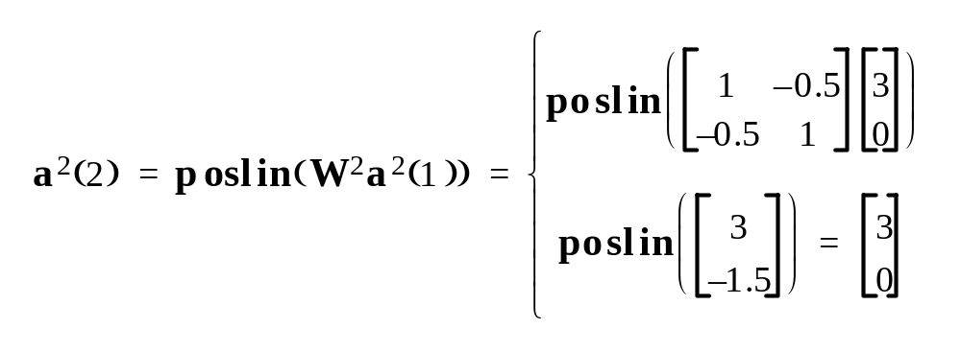
Illustrative Example
Second Layer
S = 2 , ε = 0.5

Slide 56
Illustrative Example
Since the outputs of successive iterations produce the same result, the network has converged.
Prototype pattern number one, the banana, is chosen as the correct match, since neuron number one has the only nonzero output.
Exercise:
show that the outputs of the feedforward layer are equal to:
= 2R – 2distance , where; distance = Hamming distances from the prototype patterns to the input pattern.
Consider a different value for ε provided

Slide 57
Reccurent Networks

Slide 58
Hopfield Network
This is a recurrent network that is similar in some respects to the recurrent layer of the Hamming network, but which can effectively perform the operations of both layers of the Hamming network.

Slide 59
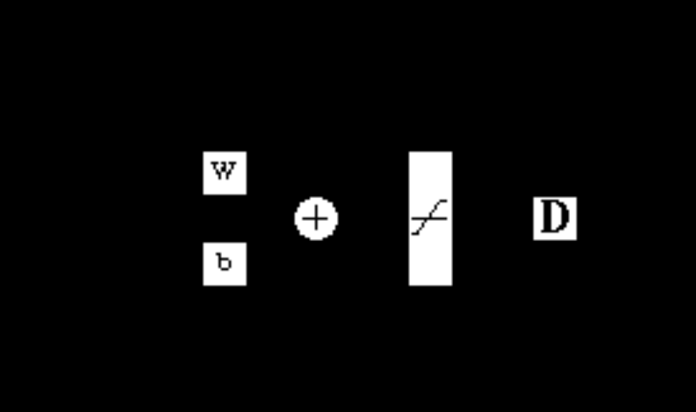
Hopfield Network

Slide 60
Hopfield Network
The neurons in this network are initialized with the input vector,then the network iterates until the output converges.
When the network is operating correctly, the resulting output should be one of the prototype vectors.
Therefore, whereas in the Hamming network the nonzero neuron indicates which prototype pattern is chosen, the Hopfield network actually produces the selected prototype pattern at its output.

Slide 61
Hopfield Network
The network is governed by the equation:
Where;
and
satlins is the transfer function that is linear in the range [-1, 1] and saturates at 1 for inputs greater than 1 and at -1 for inputs less than -1.

Slide 62
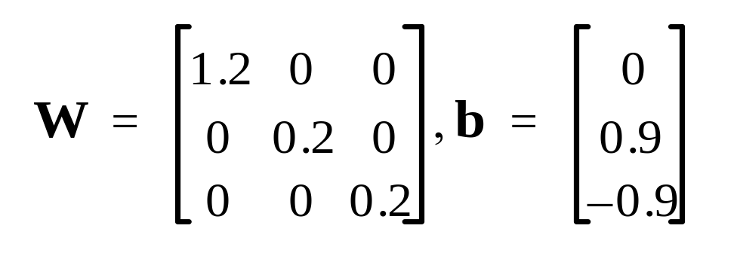
Hopfield Network
The design of the weight matrix and the bias vector for the Hopfield network is a more complex procedure than it is for the Hamming network.
Just to illustrate the operation of the network, we use a weight matrix and a bias vector that can solve our banana and apple pattern recognition problem.

Slide 63
Hopfield Network
Remark:
We want the network output to converge to either the banana pattern,p₁, or the apple pattern,p₂ . In both patterns, the second element is 1, and the third element is -1. The difference between the patterns occurs in the first element. Therefore, no matter what pattern is input to the network, we want the second element of the output pattern to converge to 1,the third element to converge to -1, and the first element to go to either 1or -1, whichever is closer to the first element of the input vector!
Prototype Banana
Prototype Apple

Slide 64

Apple/Banana Problem
Thus the equations of operation of the Hopfield network are:
Regardless of the initial values,a₁(0) , the second element will be increased until it saturates at 1, and the third element will be decreased until it saturates at -1. The first element is multiplied by a number larger than 1. Therefore, if it is initially negative, it will eventually saturate at -1; if it is initially positive it will saturate at 1.

Slide 65
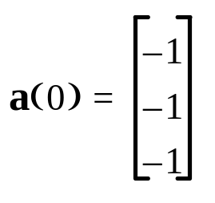
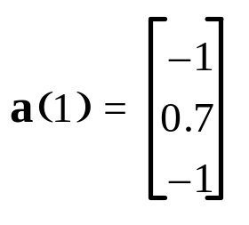
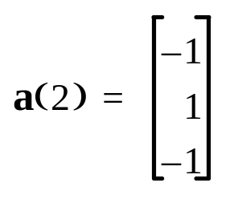
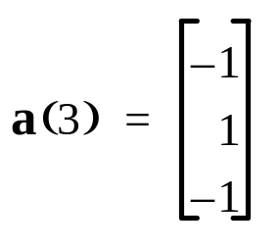
Apple/Banana Problem
Thus;
Test: “Rough” Banana
(Banana)

